Slide 1
What Sociolinguistics and Machine Learning Have to Say to One Another about Interaction Analysis
Carolyn Penstein Rosé
Language Technologies Institute and Human-Computer Interaction Institute
Carnegie Mellon University

Slide 2
No easy answers….
http://thebrianrubin.com/honore-dazed-and-confused-clip-art/

Slide 3
Outline
Why should we care about Interaction Analysis?
Caveats from Applied Machine Learning
Sociolinguistic view of Interaction analysis
Modeling Sociolinguistics with Machine Learning
Remaining Tension: Communities in Conversation

Slide 4
Outline
Why should we care about Interaction Analysis?
Caveats from Applied Machine Learning
Sociolinguistic view of Interaction analysis
Modeling Sociolinguistics with Machine Learning
Remaining Tension: Communities in Conversation

Slide 5
Social Media Analysis
Personalization
Sentiment Analysis/Opinion Mining
Sarcasm detection
Bias detection
Lie detection
Analysis of Bullying
Analysis of social support

Slide 6
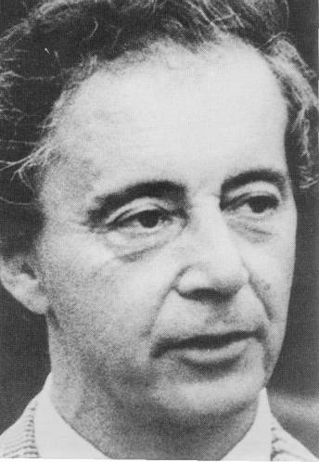
Impression Management
“Whereas some information is given intentionally (i.e., communicated by the speaker), other information is given off (i.e., expressed) unintentionally” (Goffman, 1979)
What details about a person’s communication give us an impression?

Slide 7
Typical Social Media Analysis Approach: Non-Conversational
Typical paradigm for sentiment analysis of product reviews:
Make a prediction based on text of single reviews taken out of context
Some evidence of group effects in product review blogs based on numerical ratings (Wu et al., 2008)
KEY ASSUMPTION: language is a reflection of the speaker’s perspective
… but is it only the speaker?

Slide 8
Are product reviews conversational?

Slide 9
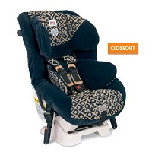
Are product reviews conversational?
“After many MANY weeks of research, gathering information from several sites, reviews etc I decided that the Britax Boulevard was definitely the safest bet available on the market. The things that sold me: All the safety gadgets that other seats don't have like the side impact wings, the HUGS system, the LATCH system and 5 point harness and also the fact that it lasts up to 29Kg. “

Slide 10
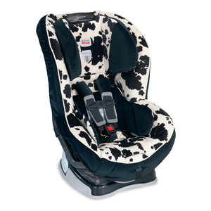
Are product reviews conversational?
“I did most of my research on the net, picking my top 3 choices I went and had a look at them in the shops. I looked at one the Graco Comfort Sport, the Britax Boulevard and the Decathlon and Marathon seats. By far it seems that Britax have the upper hand safely wise on the market, many professional reviews and crash tests agree on this so Britax was the clear choice for us. “

Slide 11
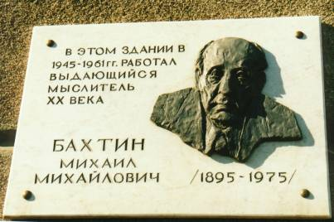
Are product reviews conversational?
http://www9.georgetown.edu/faculty/irvinem/theory/Bakhtin-MainTheory.html

Slide 12
All Language is Conversational
http://www9.georgetown.edu/faculty/irvinem/theory/Bakhtin-MainTheory.html

Slide 13
Outline
Why should we care about Interaction Analysis?
Caveats from Applied Machine Learning
Sociolinguistic view of Interaction analysis
Modeling Sociolinguistics with Machine Learning
Remaining Tension: Communities in Conversation

Slide 14
Machine Learning Myth

Slide 15
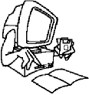
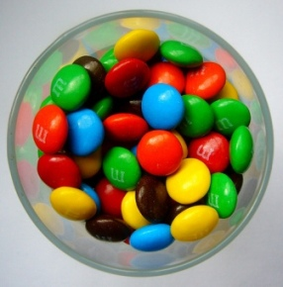
Credo of Applied Machine Learning
Machine learning isn’t magic
But it can be useful for identifying meaningful patterns in your data when used properly
Proper use requires insight into your data
?

Slide 16
What information are we throwing away or ignoring that would allow us to distinguish meaningful variation from meaningless variation?

Slide 17
What can’t you conclude from “bag of words” representations?
Causality: “X caused Y” versus “Y caused X”
Roles and Mood:
“Which person ate the food that I prepared this morning and drives the big car in front of my cat”
“The person, which prepared food that my cat and I ate this morning, drives in front of the big car.”
Who’s driving, who’s eating, and who’s preparing food?

Slide 18
Example related to sentiment: The function of “frankly”…
A I tell you frankly you’re a swine.
B Frankly, you’re a swine.
C John told Bill frankly that he was a swine.
(Levinson, 1983)
Same propositional content, but “frankly” is not functioning the same way in all of these examples. In A and C it modifies the telling event, but in B it’s a warning that something negative is coming.
What does this tell us about using words as evidence in Pragmatic oriented interpretation?

Slide 19
Understand Your Data
?

Slide 20
Are we missing something? Sociolinguists and Discourse Analysts have been studying social aspects of language since the 20s and 30s!!!

Slide 21
Displayed Bias as a Reflection of Both Projected Speaker and Assumed Hearer
Dong Nguyen, Elijah Mayfield, & Carolyn Rosé (2010). An analysis of perspectives in interactive settings, Proceedings of the KDD Workshop on Social Media Analytics

Slide 22
Perspective from Rhetoric
Author
Implied
Author
Implied
Reader
Projected author: Communication style is a projection of identity
Impression management, not necessarily the ground truth
Assumed reader: What we assume about who is listening
Real assumptions, possibly incorrect
What we want recipients or overhearers to think are our assumptions
Actual Reader: may or may not understand the text the way it was intended
Text
Effect
Reader

Slide 23
Bias Estimation
Start with LDA model (with 15 topics) of a politics discussion forum dataset
Separate texts into two collections, one left affiliated, and one right affiliated
We then have a Left model and a Right model
Compute a rank for each word w in each topic t in each model
Intuition: a word is more distinguishing for a particular point of view if it has a high probability within the associated model and a low probability in the opposite model
Bias(w,t) = log(rank_{right}(w,t) + 1) – log(rank_{left}(w,t) + 1)
The bias of a text is the average bias over the terms within the text
Left scores positive, right scores negative

Slide 24
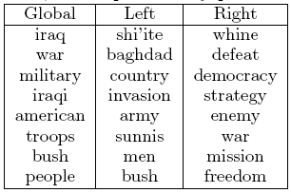
Qualitative Analysis
Terror Language (Right): evokes emotional response to thread of attack. Define target as evil and as a threat. Provokes a defensive posture.
Imperialist rhetoric (Right): racial prejudice, attitude of superiority.
Web of concern (Left): focus on opposition as individuals with a culture and history, concern for wellbeing of all people, focus on potential negative effects of war

Slide 25
Qualitative Analysis
Terror Language (Right): evokes emotional response to thread of attack. Define target as evil and as a threat. Provokes a defensive posture.
Imperialist rhetoric (Right): racial prejudice, attitude of superiority.
Web of concern (Left): focus on opposition as individuals with a culture and history, concern for wellbeing of all people, focus on potential negative effects of war

Slide 26
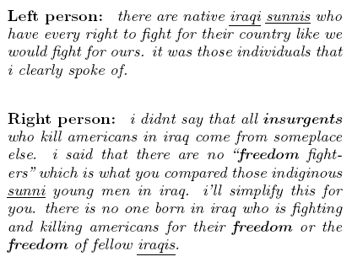
Quantitative Analysis
Right Bias
Left Bias
Quoted Message
Score of poster
Score of quoted message
Score of full post
Score of words that appear in both messages
Score of words that appear only in quoted message
Score of words that appear only in the post
Post

Slide 27
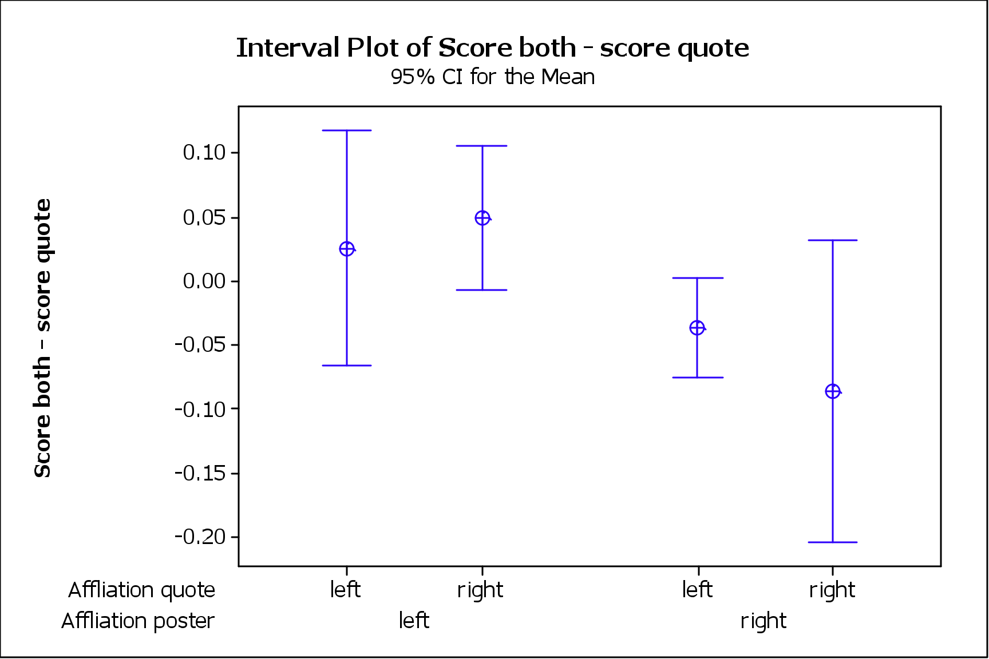
Investigation of Quoting behavior

Slide 28
Investigation of Quoting behavior
Which words are quoted?
by pointing out the inflation of Saddam’s body count by neocons in an effort to further vilify him and thus further justify our invasion we are not DEFENDING saddam....just pointing out how neocons rarely let facts get in the way of a good war.
So wait, how many do you think Saddam killed or oppressed? You’re trying to make him look better than he actually was. You’re the one inflating the casualties we’ve caused! Seriously, what estimates (with a link) are there that we’ve killed over 100,000 civilians. Not some crack pot geocities page either.

Slide 29
Investigation of Quoting behavior
Negative correlation between words only in quoted message and words only in post (r=-0.1, p < 0.05)
Positive correlation between score of quoted words and score of the whole post (r=0.18, p < 0.02)
Score of words only in post are significantly more reflective of the affiliation of the poster than that of the author of the quoted message
Similar result with score of words only in quote with affiliation of author of quoted message

Slide 30
Overview of Findings
Evidence that both projected author and assumed hearer are reflected in our lexical choices:
Quotes from opposite point of view include the words that are less strongly associated with the opposite perspective
Because of quotes, displayed bias shifts towards the bias of the person to whom the message is directed
Personal bias of the speaker is most strongly represented by non-quoted portions of text

Slide 31
Outline
Why should we care about Interaction Analysis?
Caveats from Applied Machine Learning
Sociolinguistic view of Interaction analysis
Modeling Sociolinguistics with Machine Learning
Remaining Tension: Communities in Conversation

Slide 32
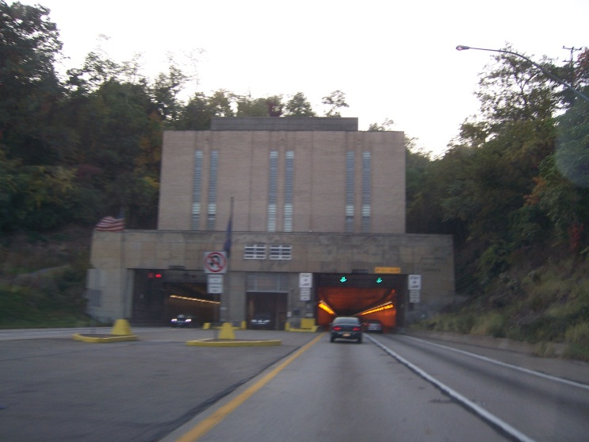
Discourse and Identity
Identity is reflected in the way we present ourselves in conversational interactions
Reflects who we are, how we think, and where we belong
Also reflects how we think of our audience
Examples
Regional dialect: shows my identification with where I am from, but also shows I am comfortable letting you identify me that way
Jargon and technical terms: shows my identification with a work community, but also shows I expect you to be able to relate to that part of my life
Level of formality: shows where we stand in relation to one another
Explicitness in reference: shows whether I am treating you like an insider or an outsider

Slide 33
Systemic Functional Linguistics
What do form-function correspondences look like?
“Discourse analysis employs the tools of grammarians to identify the roles of wordings in passages of text, and employs the tools of social theorists to explain why they make the meanings they do.”
(Martin & White, 2005)

Slide 34
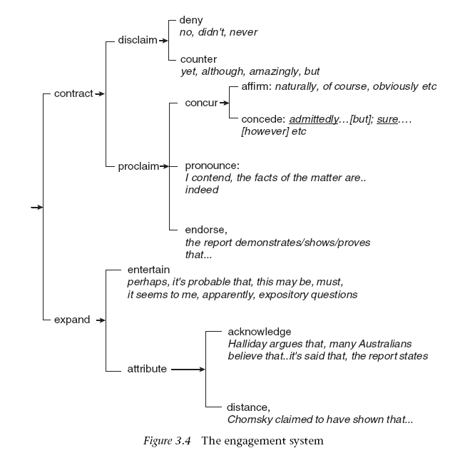
Engagement: Social positioning in conversational style
Author
The message: Most contributions express some content
Projected author: How I phrase it says something about my stance with respect to that content
Assumed reader: Also says something about what I assume is your stance and my stance in relation to you
Actual Reader: The hearer may respond either to the message or its positioning
Implied
Author
Implied
Reader
Text
Effect
Reader

Slide 35
The Future of Computing?

Slide 36
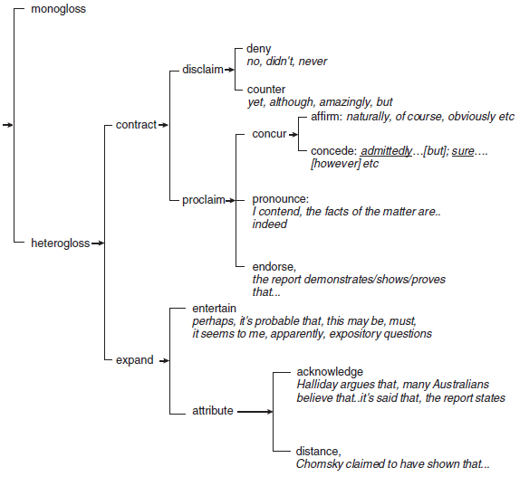
Heteroglossia (Martin & White, 2005, p117)
System of Engagement
Showing openness to the existence of other perspectives
Less final / Invites more discussion
Example:
[M] Iron Man is a good movie
[HE] I consider Iron Man to be a good movie
[HC] There’s no denying that Iron Man is a good movie
[NA] Is Iron Man a good movie?

Slide 37
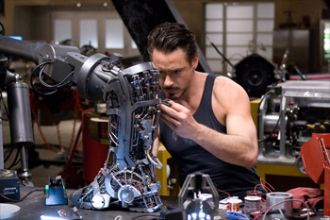
Line | Text | Authority | Heterog.
1 | Stark: Give me an exploded view. | A2 | M
2 | Jarvis: The compression in cylinder three appears to be low. | K1 | HE
3 | Stark: Log that. | A2 | M
4 | Stark: I'm gonna try again, right now. | A1 | M
5 | Stark: Hey, Butterfingers, come here. | A2 | M
6 | Stark: What's all this stuff doing on top of my desk? | K2 | NA

Slide 38
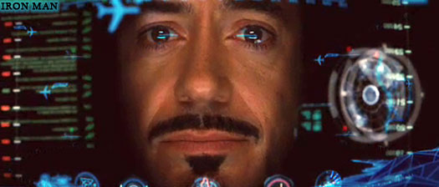
Towards evaluating the quality of futuristic human-computer interaction paradigms…
Jarvis: Test complete. Preparing to power down and begin diagnostics.
Stark: Yeah. Tell you what. Do a weather and ATC check.
Stark: Start listening in on ground control.
Jarvis: Sir, there are still terabytes of calculations needed before an actual flight is...
Stark: Jarvis! Sometimes you got to run before you can walk. [HC]
“Iron Man” Film Script, 59:10.
Usability Heuristic: Good feedback
Usability Heuristic: Avoiding errors???
http://www.filmofilia.com/tag/iron-man/page/3/

Slide 39
Outline
Why should we care about Interaction Analysis?
Caveats from Applied Machine Learning
Sociolinguistic view of Interaction analysis
Modeling Sociolinguistics with Machine Learning
Remaining Tension: Communities in Conversation

Slide 40
Methodology
Theory
Research Questions
Interpretation
Data
Patterns

Slide 41
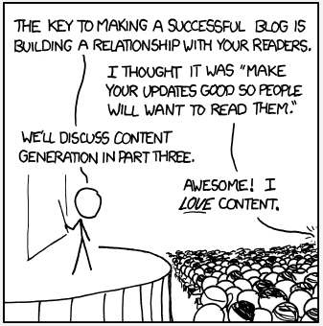
Blogging!
http://blogging.la/2011/05/30/blogging-in-la-going-weekly/

Slide 42
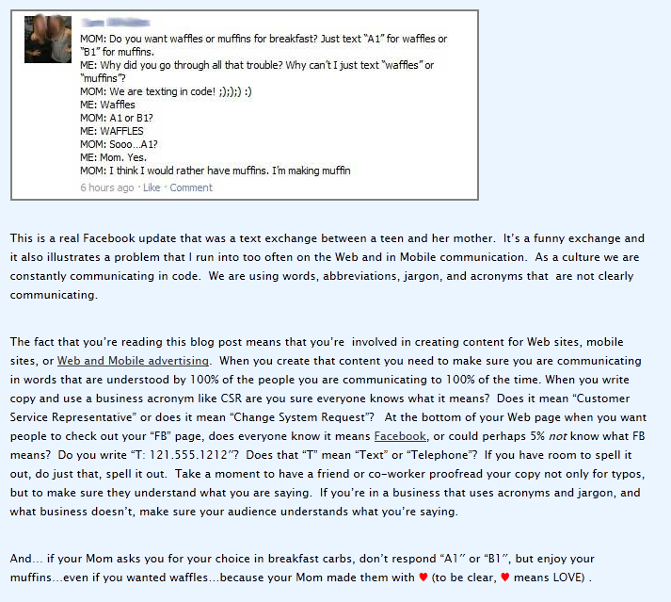
Blog Authorship: Male or Female?

Slide 43
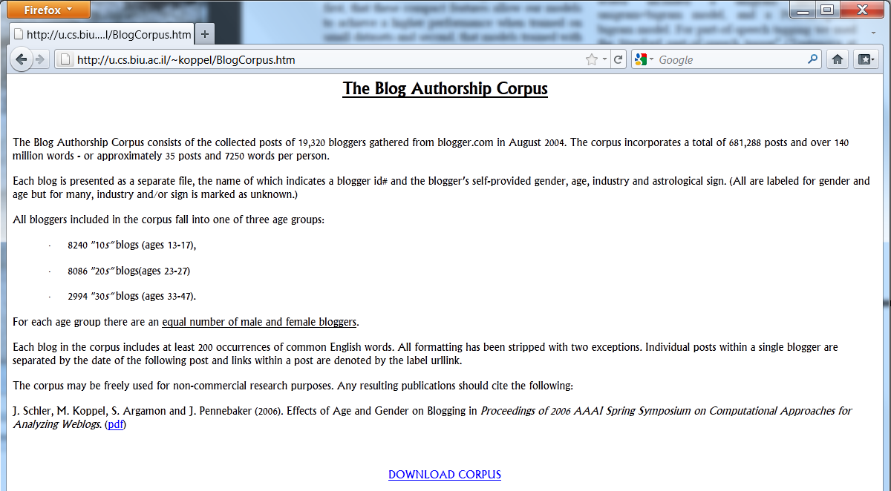

Slide 44
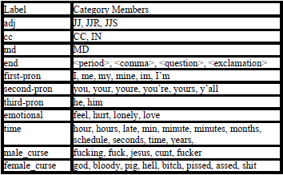
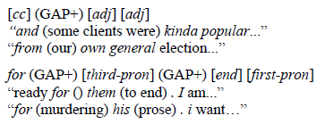
Stretchy Patterns (Gianfortoni, Adamson, & Rosé, 2011)
A sequence of 1 to 6 categories
May include GAPs
Can cover any symbol
GAP+ may cover any number of symbols
Must not begin or end with a GAP

Slide 45
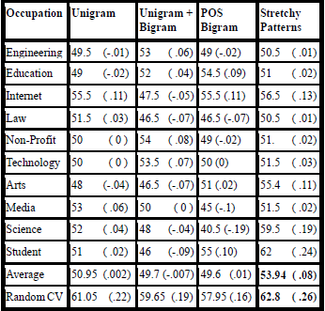
Evaluation of Domain Generality
Contrast random CV and leave-one-occupation-out CV
All feature space representations show significant drop between random CV and leave-one-occupation-out CV
Only stretchy patterns remain significantly above random performance

Slide 46
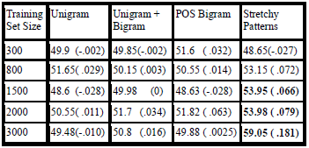
Evaluation of Learning Efficiency
Train and test on sampling across all occupations
Always test on the same set
Training sets vary by size
No significant differences in performance with smallest training set
Significant advantage for Stretchy Patterns at all other training set sizes

Slide 47
Does that mean we succeeded in modeling gender?

Slide 48
Methodology
Theory
Research Questions
Interpretation
Data
Patterns

Slide 49
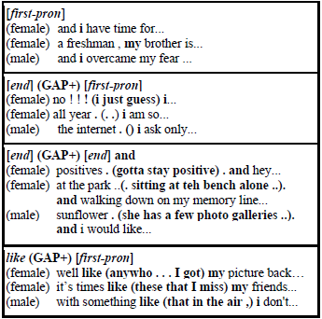
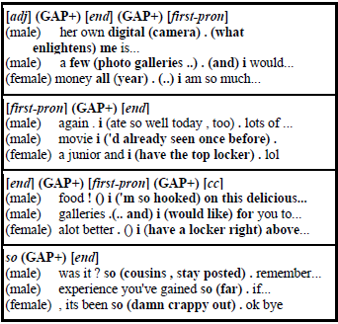
What did we learn about gender and blogging?
?
Female Patterns
Male Patterns

Slide 50
Outline
Why should we care about Interaction Analysis?
Caveats from Applied Machine Learning
Sociolinguistic view of Interaction analysis
Modeling Sociolinguistics with Machine Learning
Remaining Tension: Communities in Conversation

Slide 51
Controversy over the nature of identity
Identity is a function of social categories like gender, ethnicity, etc.
Identity is highly individual and constructed in the moment
Positivism
Constructivism
Makes sense to study with a quantitative methodology
Makes sense to study with a constructivist/ qualiataive methodology
Variationist sociolinguistics
Interactional Sociolingusitics
Methodology reflects our assumptions about the nature of what we are studying.
Is a machine learning approach inherently variationist?

Slide 52
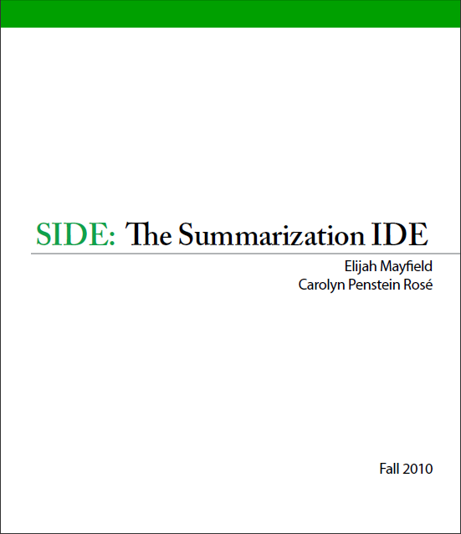
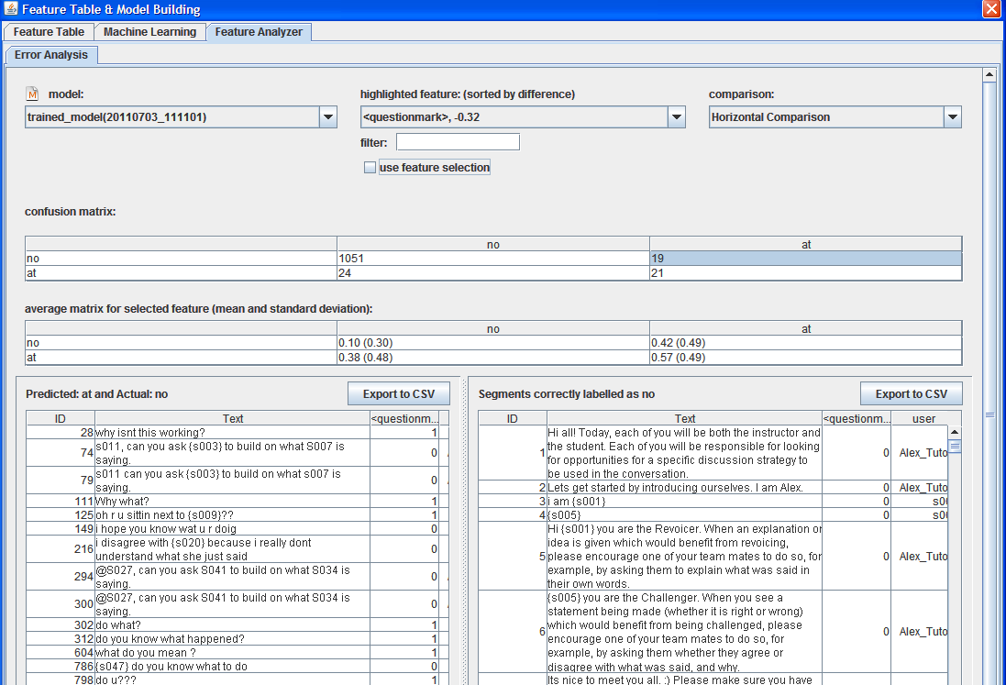
Conclusions
http://www.cs.cmu.edu/~cprose/SIDE.html
All language analysis is interaction analysis
The fields of Discourse Analysis and Sociolinguistics challenge the assumptions behind our approaches
Machine learning is only part of the process of understanding interaction
We’re left with difficult tensions between competing research paradigms
What can we do: Strive to Understand our Data!!!

Slide 53
Interest in Collaboration?

Slide 54
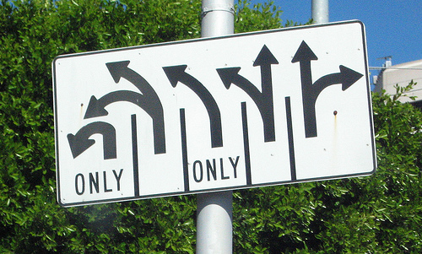
Questions? Carolyn Penstein Rosé, cprose@cs.cmu.edu, http://www.cs.cmu.edu/~cprose

